Slide 1

Cluj Real Estate 2023 – Case study Exploratory data analysis
Project created by Stark Catalin Dumitru

Slide 2
Contents
Objective
Data overview
Data explanation
Conclusions

Slide 3
1. Objective
The purpose of this analysis was to do an overview of the Cluj real estate market to determine the average prices based on criteria like number of rooms, furniture or dimensions.
For a detailed breakdown on how I have extracted the data and processed it, please see the Exploratory “Data Analysis Project overview.pptx” file where I have explained my challenges for this project and the steps I took to overcome them.
For a summarized version of this presentation in a form of a Dashboard, please visit the “Cluj_RealEstate_Analysis.xlxs” file.

Slide 4

2. Data Overview
For this analysis, I have used one dataset which was acquired by web scraping with Power BI and Power Query to get 9714 results for apartments with the following data: Description, Price, type of apartment and dimensions. Please be advised that the original data set has been modified since the original header columns had the names in Romanian.

Slide 5
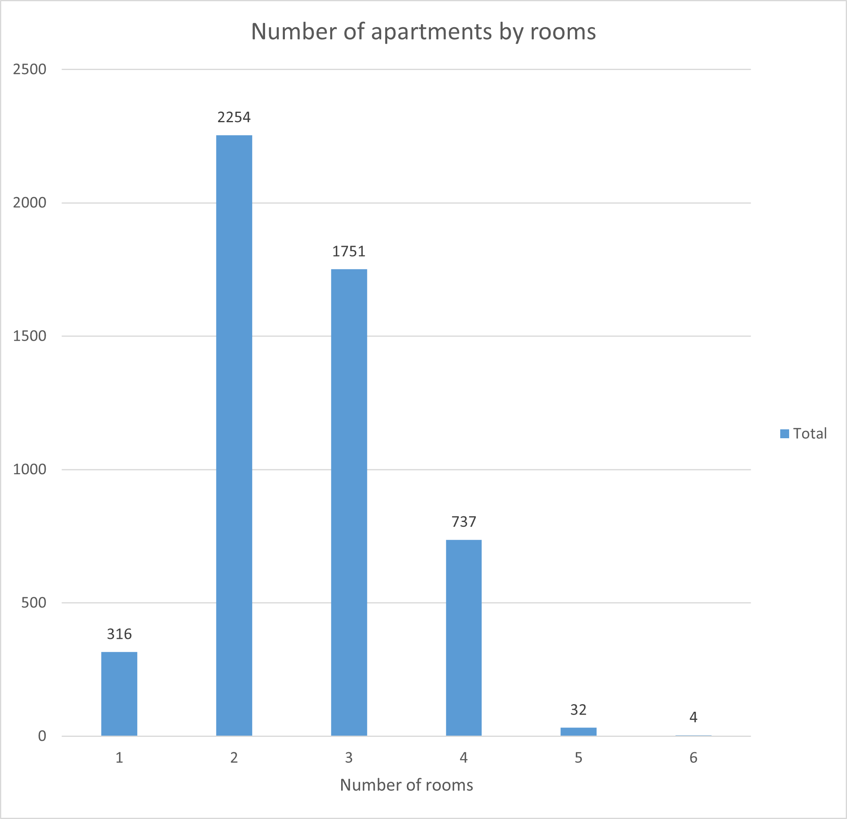
3. Data explanation
The first thing I wanted to find out was how many apartments are in Cluj-Napoca. The chart from the left illustrates the number of apartments by the number of rooms it contains.
The total number amounts to 5094 apartments for sale. As you can see in the image, the market is dominated by the apartments with 2 rooms, where the average dimension in square meters is of about 58 m2 and an average price of 149027 euros.

Slide 6
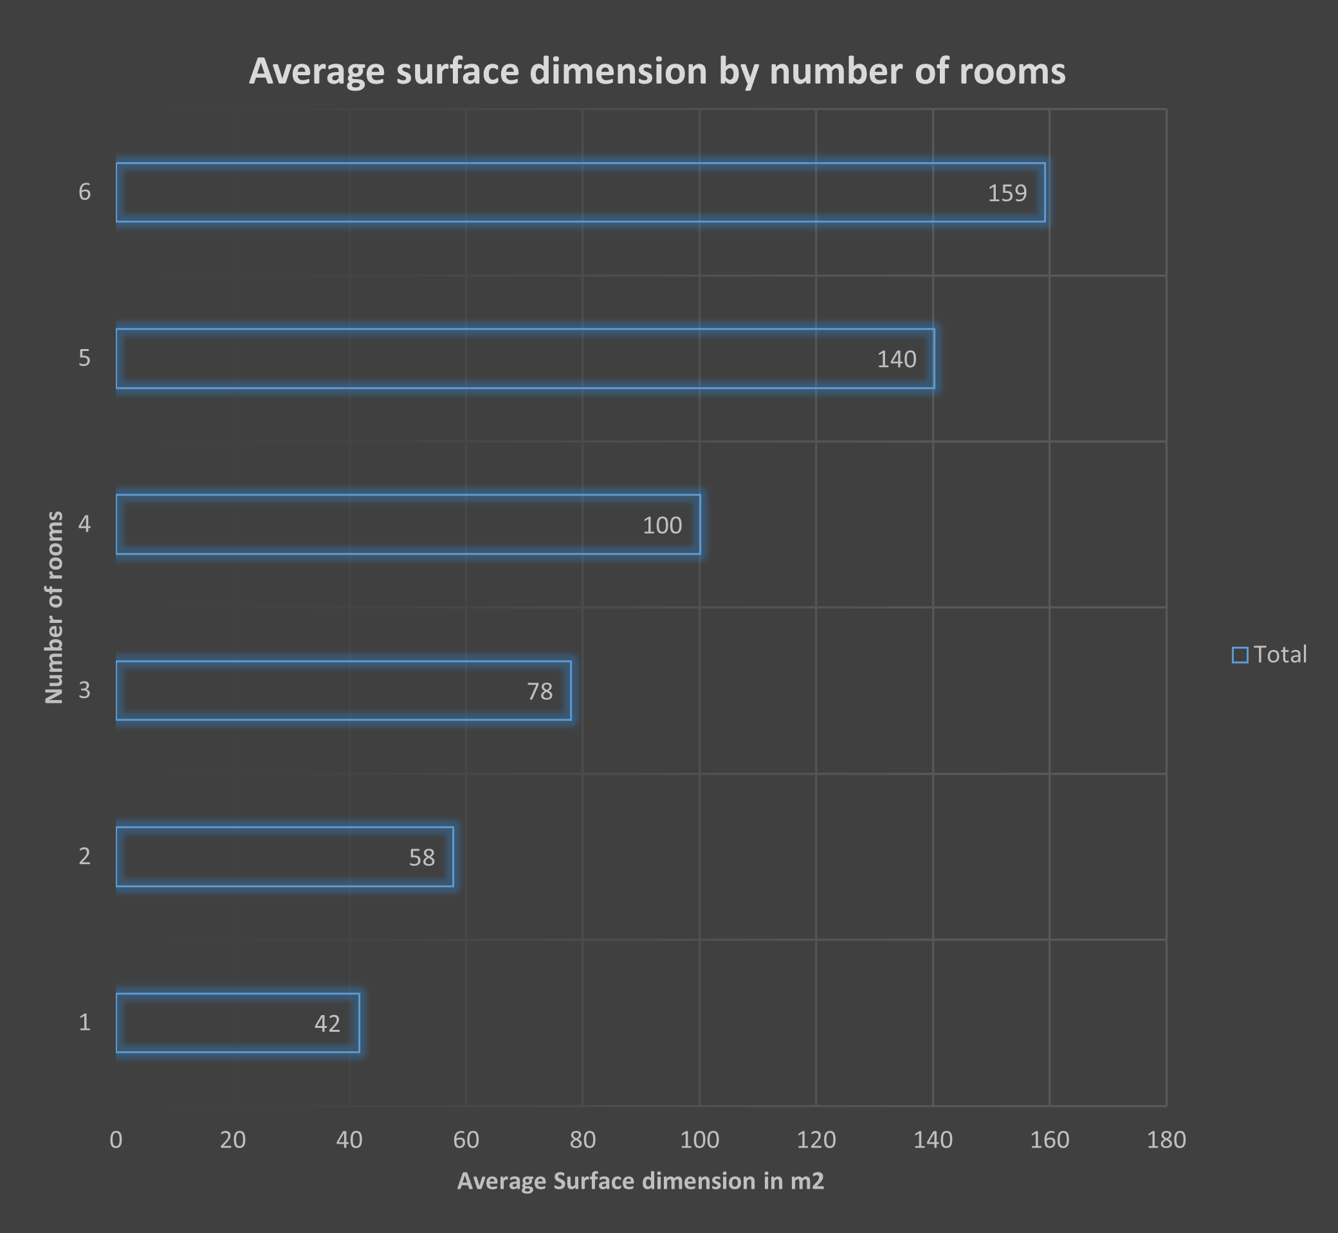
In this chart, I wanted to highlight the average dimensions of an apartment. For example, the average dimension of an apartment with 3 rooms would be 78 square meters.
For me personally, this chart helps me determine for which apartment should I go and buy based on my personal needs.
Since I work mostly from home, I would consider going for a 2 rooms apartment, so I can have a bedroom and an office room and with a more accessible price than the other apartments.

Slide 7
Before talking about the prices of the apartments in Cluj, I want to point out a few aspects about this analysis:
The financial part of this project does not consider the mortgage side of buying an apartment. For that, there are online simulators that calculates the monthly mortgage based on apartment price, monthly pay, interest and so on.
The aim of this project is to see how much does an apartment cost in Cluj-Napoca, which is the Transylvania’s University center and the IT capital of Romania, and it is considered to be one of the most expensive cities in Romania along with other cities like Bucharest and Timisoara.

Slide 8
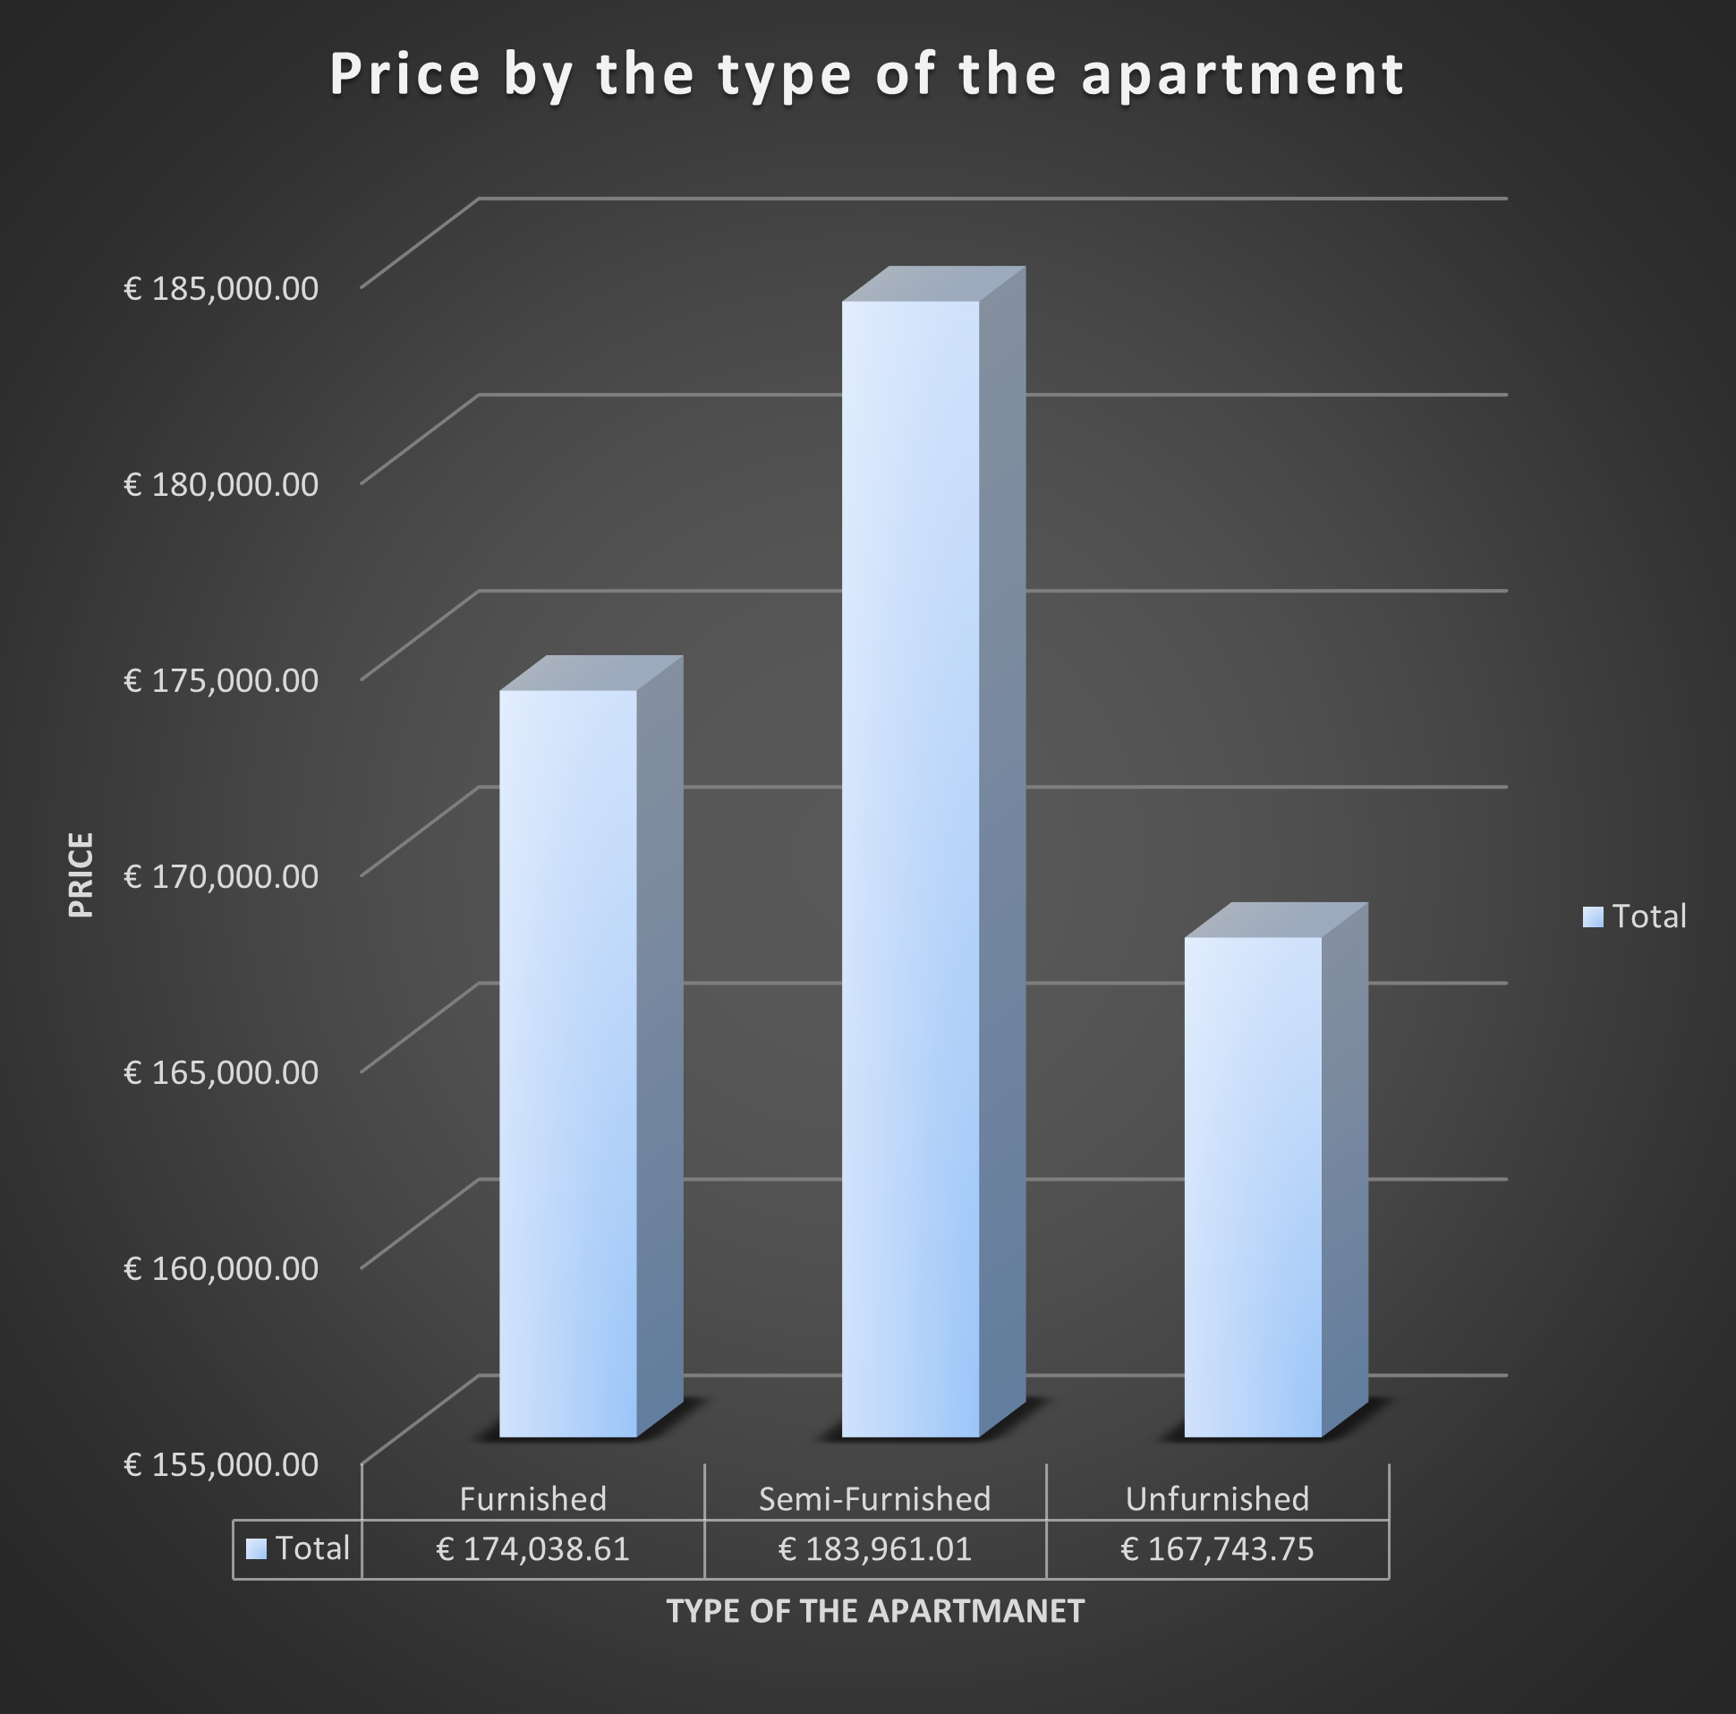
In this chart can be seen the average price of an apartment based on the furniture it has. As you can see, the biggest difference in price, but also in the quantity of apartments on the market is between the ones that are furnished and the other ones that have no furniture. The apartments with no furniture represent only 0.31 % of the total market of apartments in Cluj.
For me personally, I would go with the unfurnished apartment since with the extra money I could furnish, and custom made my apartment the way I would like to have it.

Slide 9
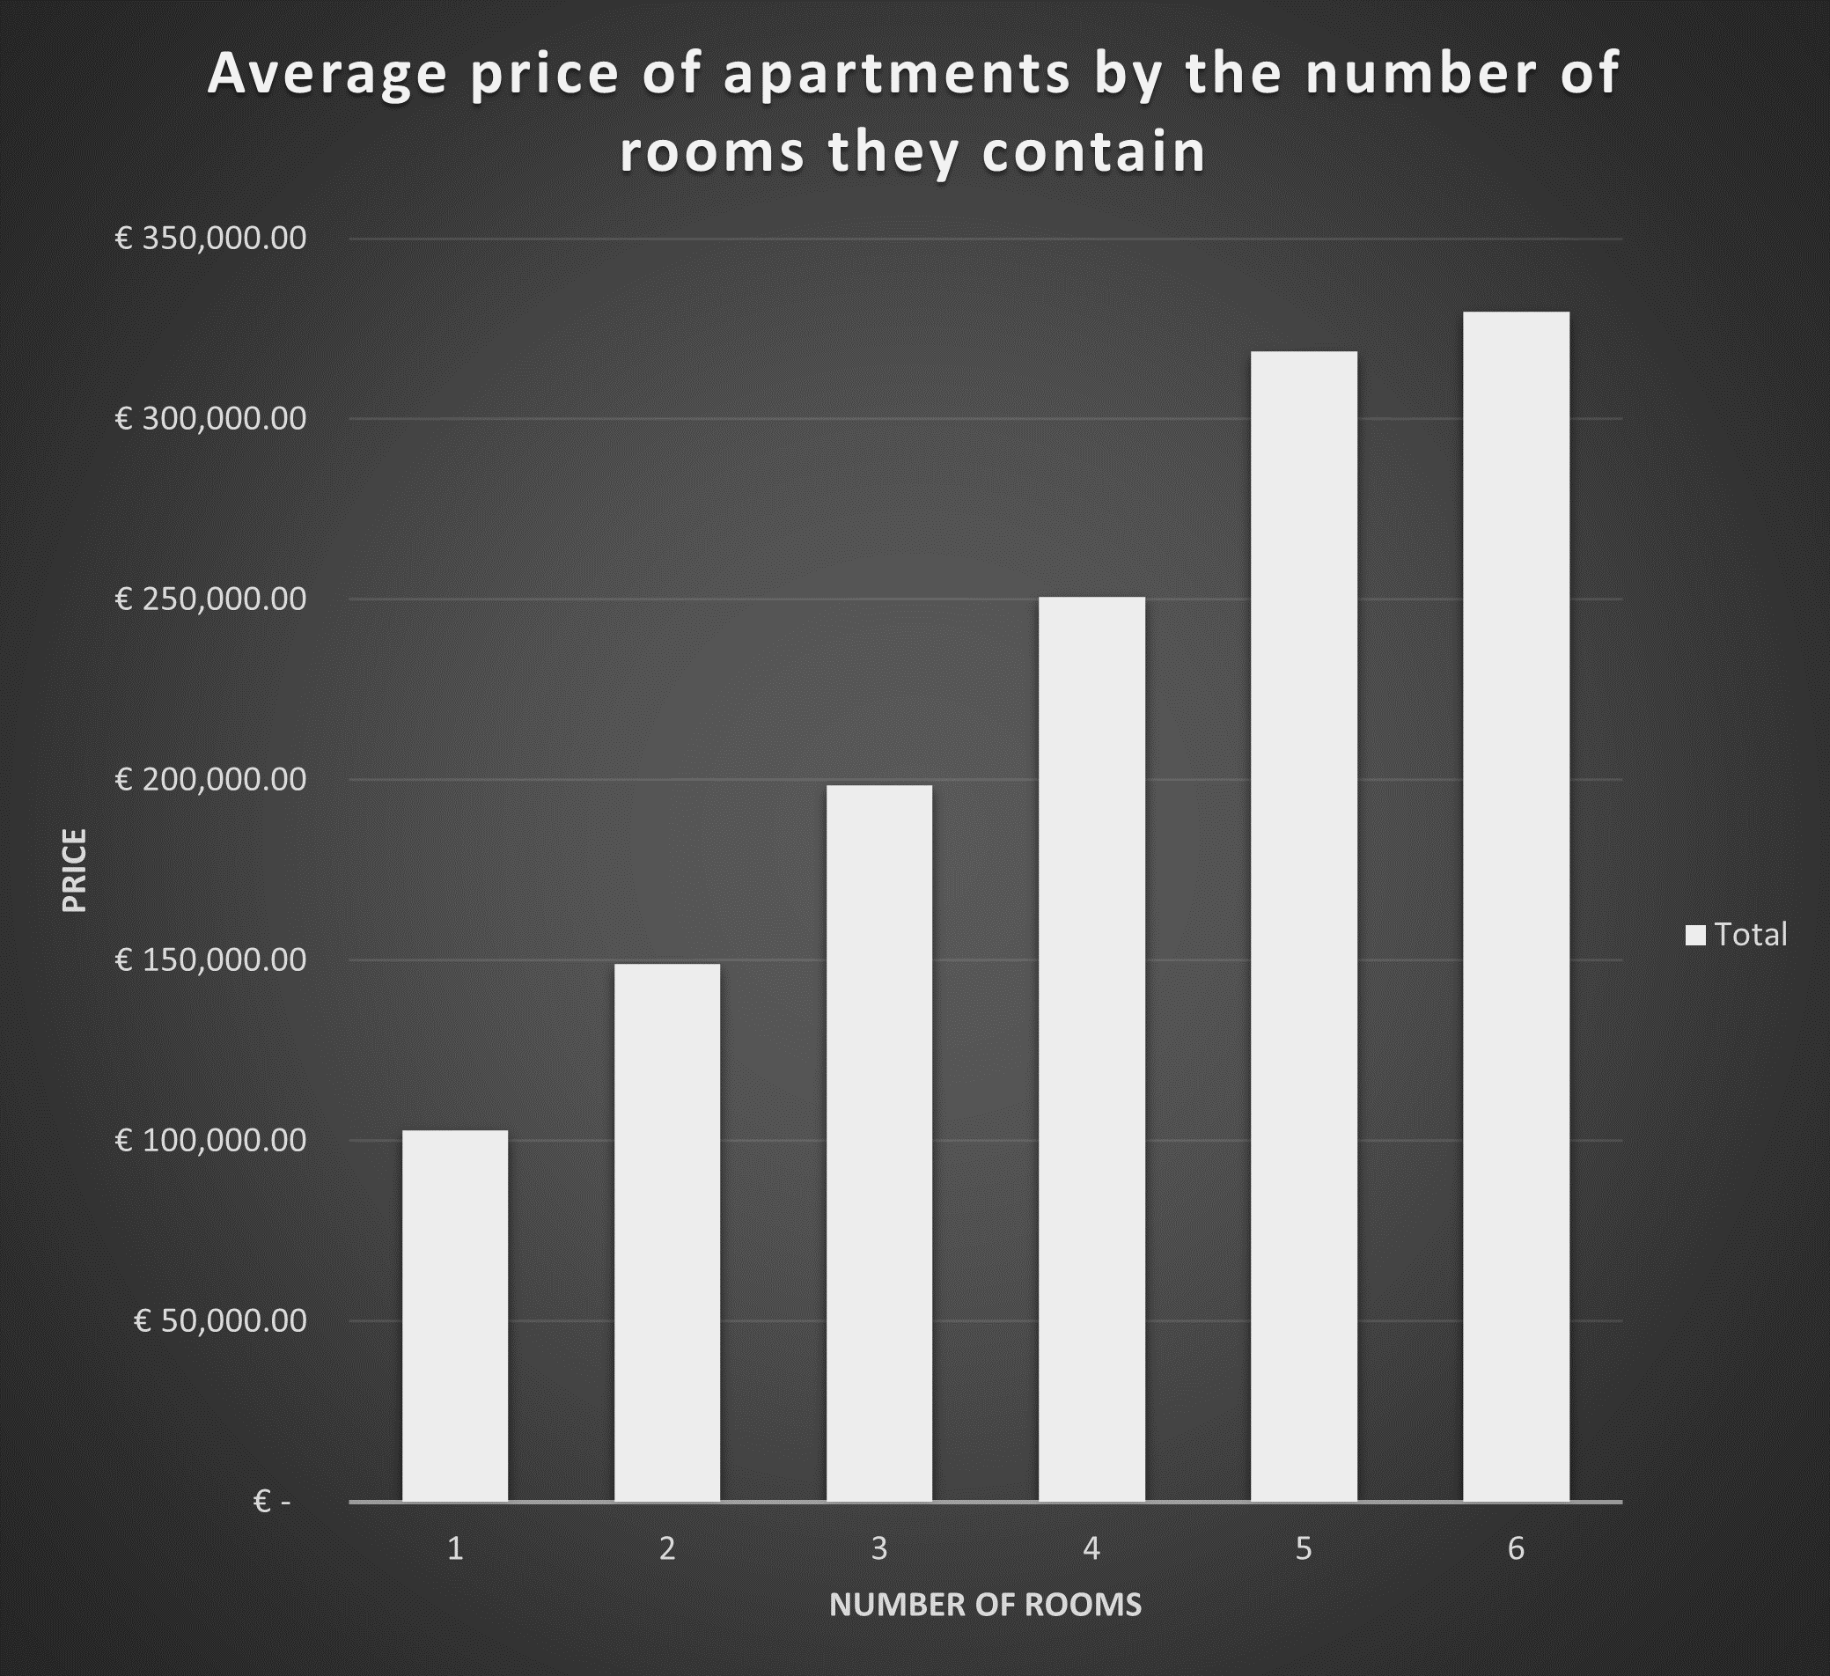
In this chart above it is represented the average price of apartments by how many rooms an apartment has.

Slide 10
General information on the Cluj Apartment market
The average price for an apartment is 179059.90 euros.
The average surface dimension in square meters is 70.

Slide 11
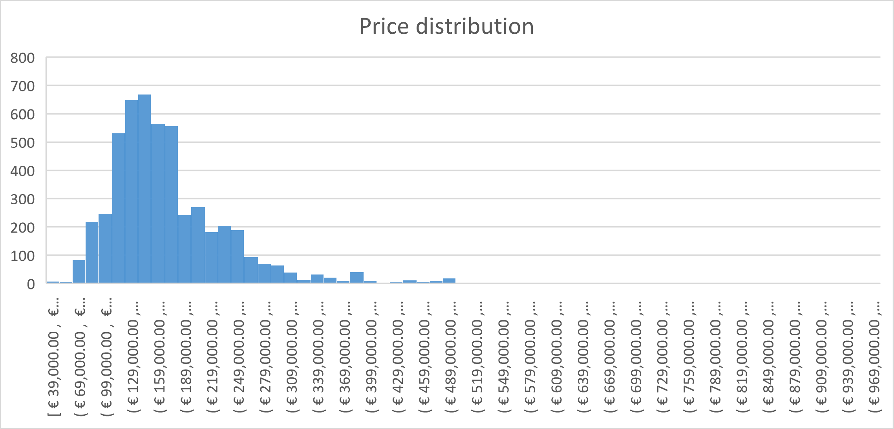
In the chart above, a right skewed histogram is represented which show the distribution of prices with a standard deviation of approximately 75000 euros. On the Y axis it is represented the frequency of a certain price and on the X axis the prices itself.

Slide 12
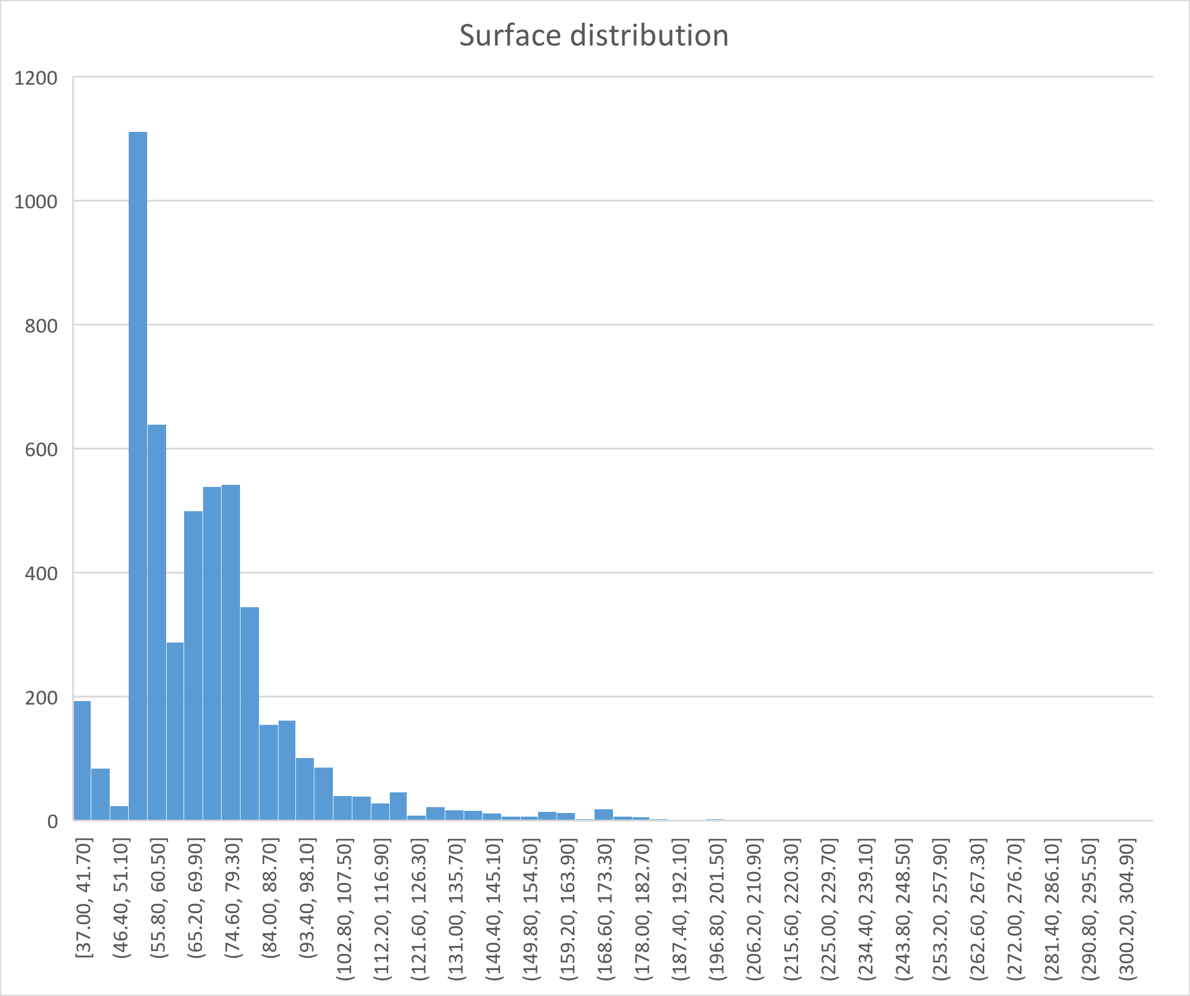
In this chart, the surface distribution is represented through a histogram, which is also right skewed. On the Y axis it is represented the frequency of a surface dimension in square meters and on the X axis the dimensions.

Slide 13
General information about apartments with 2 rooms

Slide 14
4. Conclusions
According to some financial magazines like ZF.ro, the average wage in Romania is 863 euros. If we take the average price in Cluj for an apartment which is 179059 euros and divide by the average wage, we get 175 which represents how many average salaries it would take to buy an apartment.
When buying an apartment, I like to look also through the lens of an investor in a company. If we compare one square meter to one stock of a company, the average price of a stock or an equity in a company would be 2543.54 euros.
Based on arguments and information presented in this project, I would go with an apartment with 2 rooms.

Slide 15

Thank you

